Slide 1
Womersley Flow
Steven A. Jones
BIEN 501
Wednesday, April 9, 2008

Slide 2
Womersley Flow
Major Learning Objectives:
Apply the assumptions of Poiseuille flow to oscillating flow in a pipe.
Obtain the momentum equation for this flow.
Solve the partial differential equation through complex variables.
Relate the flow velocity profile to centerline velocity, flow rate, wall shear stress, and pressure gradient.

Slide 3
Womersley Flow
Minor Learning Objectives:
Show that the simplifications we arrived at for Poiseuille flow are consequences of fully developed flow.
Apply the momentum equation for a case that involves time and space.
Use complex analysis in the solution of a partial differential equation.
Use complex analysis to recast the solution in the form of centerline velocity instead of pressure gradient.
Apply superposition to obtain a solution for an arbitrary waveform.

Slide 4
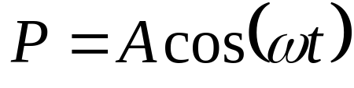
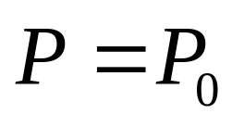
Womersley Flow

Slide 5

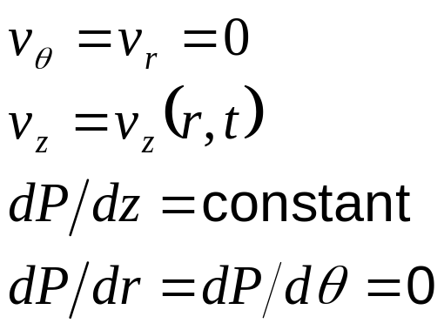
Womersley Flow
Laminar pipe flow, but with an oscillating pressure gradient,
Approximation of pulsatile flow in an artery.
The above “assumptions” can be obtained from the single assumption of “fully developed” flow.

Slide 6
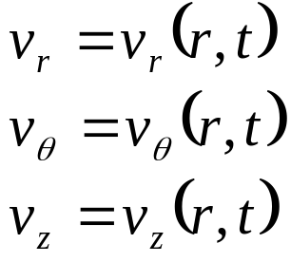
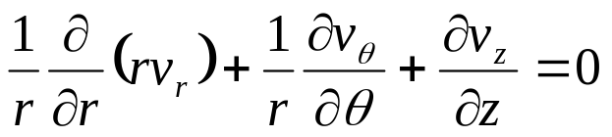
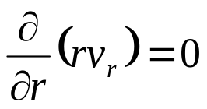
Fully Developed Flow
In fully developed pipe flow, all velocity components are assumed to be unchanging along the axial direction, and axially symmetric i.e.:
Examine continuity (for incompressible flow):
0 (no changes in z)
0 (symmetry)

Slide 7


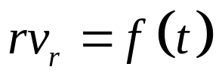
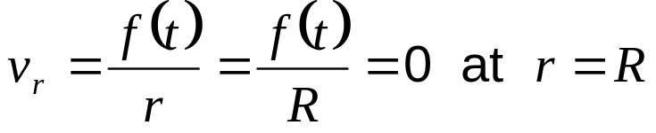
Fully Developed Flow
From
we conclude
But since we have already ruled out dependence on θ and z,
But
so that f(t) must be zero.
It follows that there is no radial velocity, i.e. v_{r}(r,t)=0.
Note: It is possible to show from the θ momentum equation that v_{θ} must also be zero. We will save that for a day when you really need the extra excitement.

Slide 8
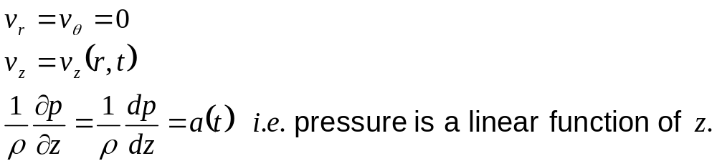
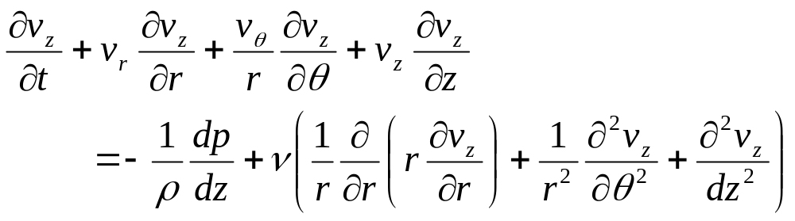
Results from Mass/Momentum
Through arguments similar to the above, we find that:
Now look at the z-momentum equation.

Slide 9
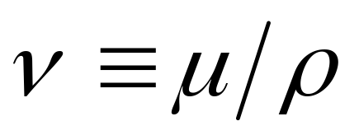
Kinematic Viscosity
The kinematic viscosity is defined by:
Do not confuse ν with the velocity v. Yes, they do look very similar, but ν will not appear with a subscript.

Slide 10
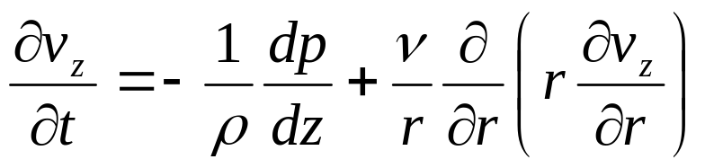
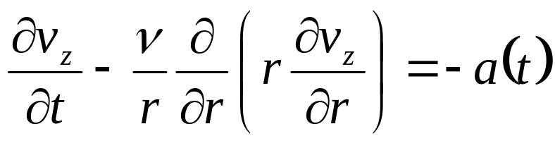
Results from Mass/Momentum
The removal of the indicated terms yields:
Or rearranging, and substituting for the pressure gradient:
In a typical situation, we would have control over a(t). That is, we can induce a pressure gradient by altering the pressure at one end of the pipe. We will therefore take it as the input to the system (similar to what an electrical engineer might do in testing a linear system).

Slide 11
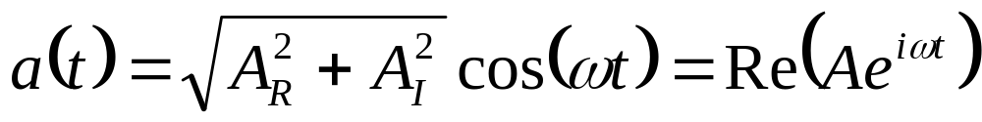
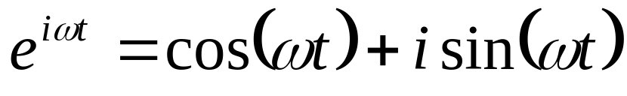


The Pressure Gradient
The form we select for the pressure gradient is:
Where the subscript R represents the real part of A. Recall Euler’s rule:
We also define a complex form of the axial velocity:

Slide 12

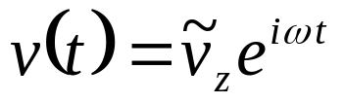
Complex Velocity
It is important to remember the following theorem:
If we have a linear differential equation
Where L{} is a linear differential operator, and if:
Solves the equation, then the real part and the imaginary part of v(t) must satisfy the equation individually.

Slide 13
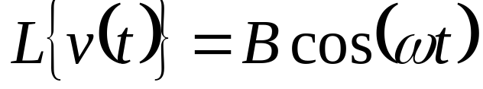

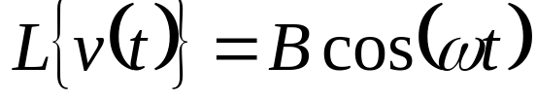
Complex Velocity
Therefore, instead of solving the equation:
We can solve the equation:
and take the real part of the solution afterwords to obtain the solution to:

Slide 14
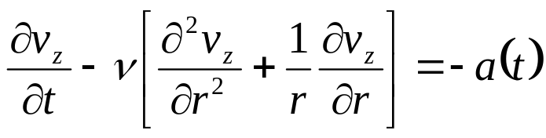
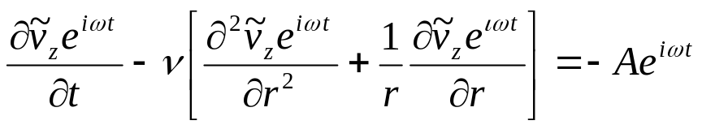
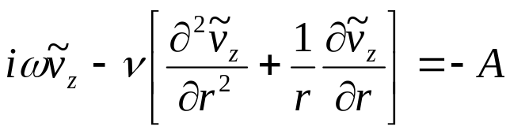
Reduction to an Ordinary Differential Equation
With these concepts in mind, we substitute for the pressure gradient and for the velocity in the momentum equation.
Divide by e^{iωt}
Through this process, we have removed the time dependence from the equation. This method is similar to a separation of variables method, where v_{z}=T(t)R(r).

Slide 15
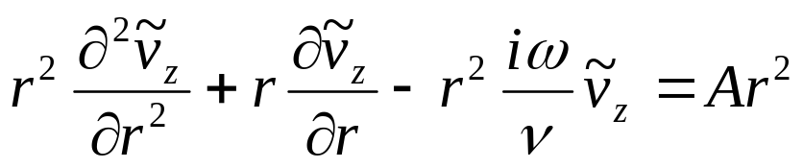
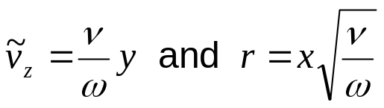
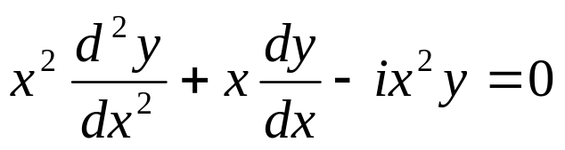
Reduction to an Ordinary Differential Equation
If we had merely assumed that v_{z}=T(t)R(r), we would have obtained the same result.
If we set
The homogeneous equation is transformed into:

Slide 16
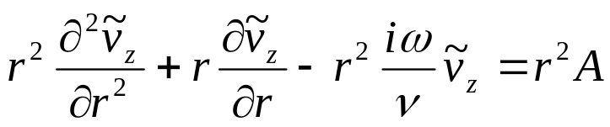
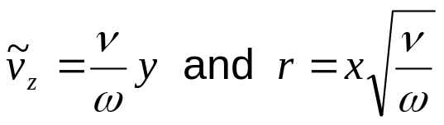
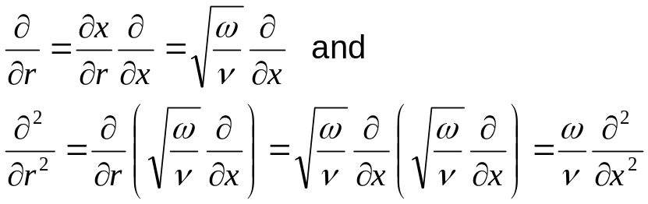
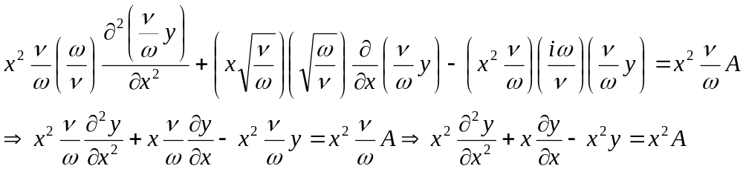
Reduction to an Ordinary Differential Equation
From
∂/∂r
v_{z}
r

Slide 17
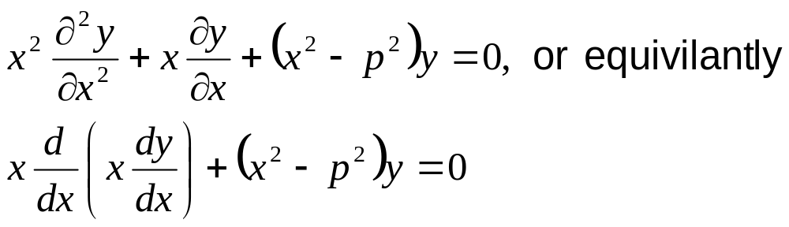
Bessel’s Equation
The above equation:
Should be compared to the canonical form of Bessels equation:

Slide 18
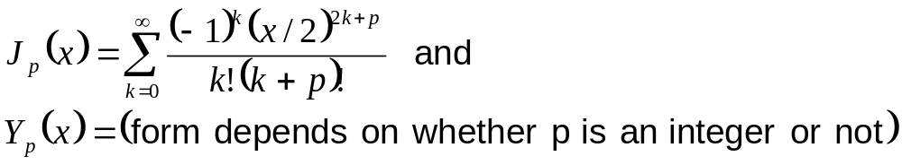
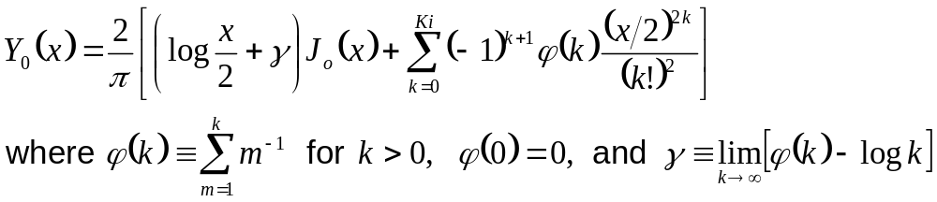
Bessel’s Equation
The solutions to Bessel’s equation are of the form:
When p=0.
In all cases, Y_{p} becomes infinite at r = 0, so it is not relevant to our case.

Slide 19
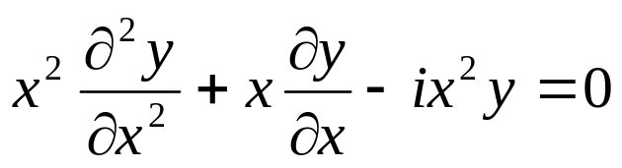
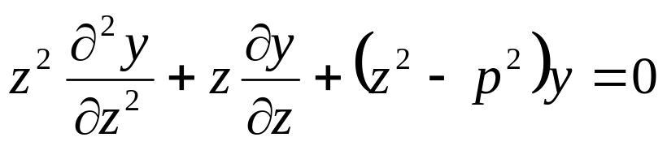
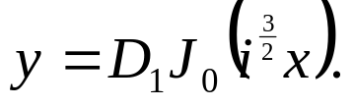
Bessel’s Equation
With the homogeneous equation:
Compared to the canonical form of Bessel’s equation:
We can deduce that p=0 and the solution is of the form
This form can be verified by substituting z=i^{3/2}x into Bessel’s equation.

Slide 20
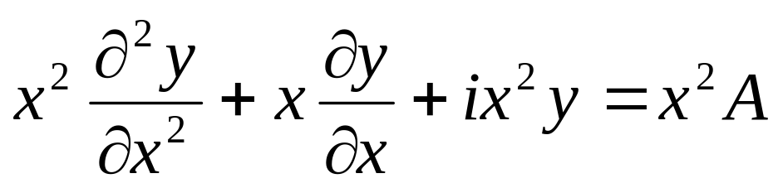
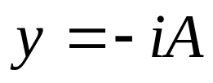
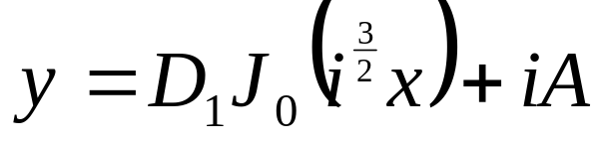
Particular Solution
From direct substitution, it can be verified that the particular solution to:
is
We can deduce that the complete solution is of the form:

Slide 21
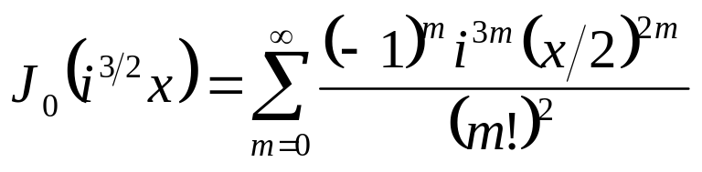
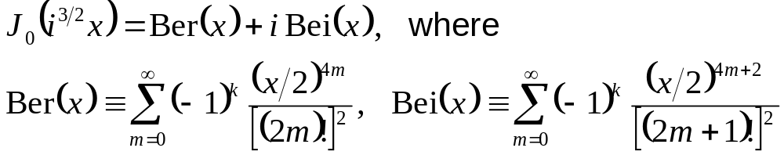
Ber and Bei Functions
Despite the complication of the complex argument, the Bessel function above has a relatively simple formulation.
The real and imaginary parts of this function are called the Ber and Bei functions, respectively.

Slide 22
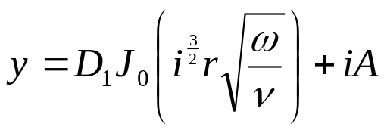
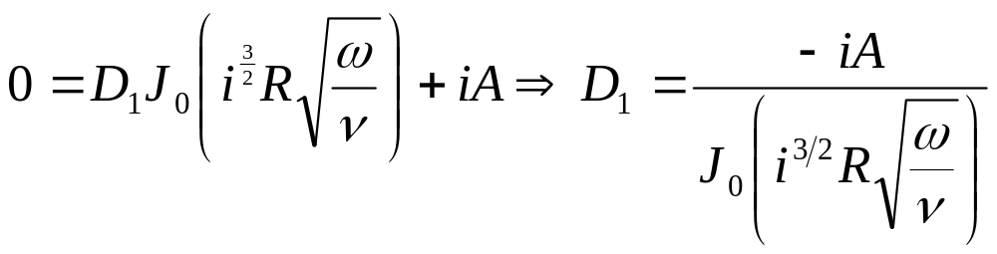
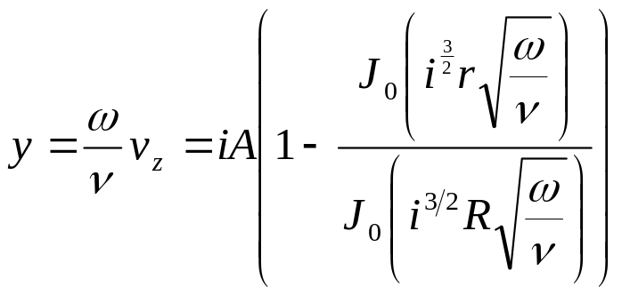
Boundary Conditions
With we must satisfy the no-slip
condition at r = R.
Therefore,

Slide 23
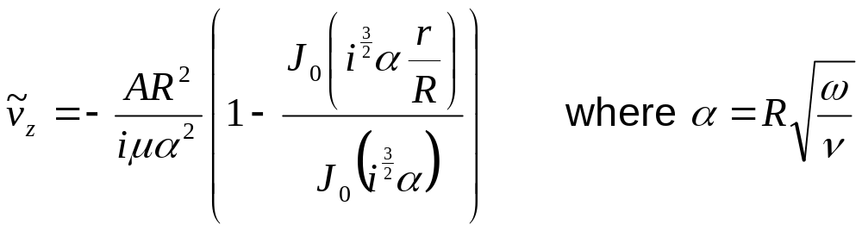
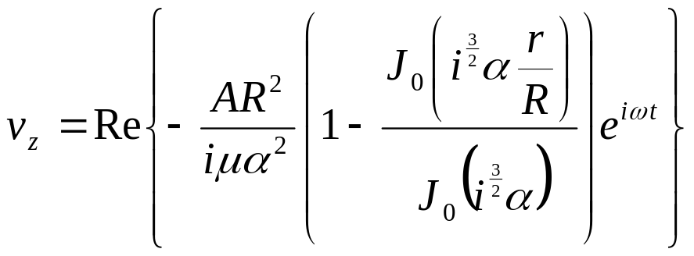
Particular Solution Equation
Now back out from x to r and from y to v_{z}.
or

Slide 24
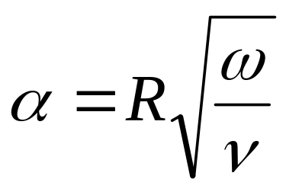
Womersley Number
The parameter
Is called either the Womersley number of the alpha parameter. It is a measure of the ratio of the unsteady part of the momentum equation to the viscous part. When α is small, the unsteadiness is not important, and the solutions become parabolas (Poiseuille solutions) that vary in magnitude, but not in shape. If α is large, however, the shapes of the profiles are not parabolic.

Slide 25
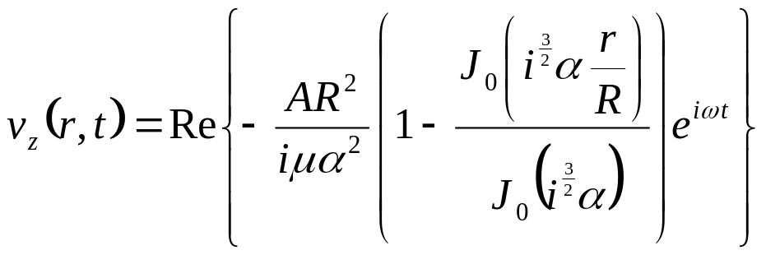
Complex Form
The complex form:
is less frightening than it looks. General computational software, such as MatLab has built in functions for the Bessel functions, and it can also handle the complex arithmetic. One can therefore literally program the above expression in MatLab and take the real part to obtain the physical (real) velocity.

Slide 26
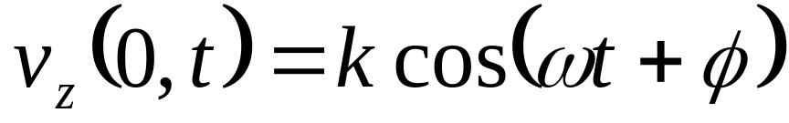
Centerline Velocity
Above is the solution for velocity in terms of the pressure gradient A. What if we have a case where the pressure gradient was not measured, but the centerline velocity was. We can write an expression for velocity in terms of the centerline velocity given in the form:

Slide 27
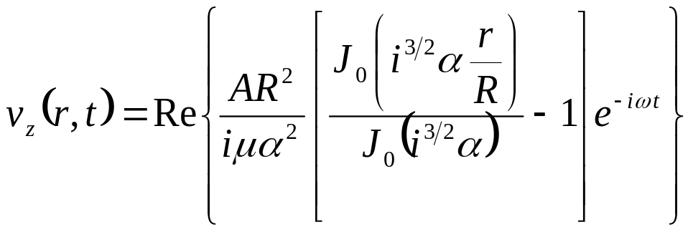
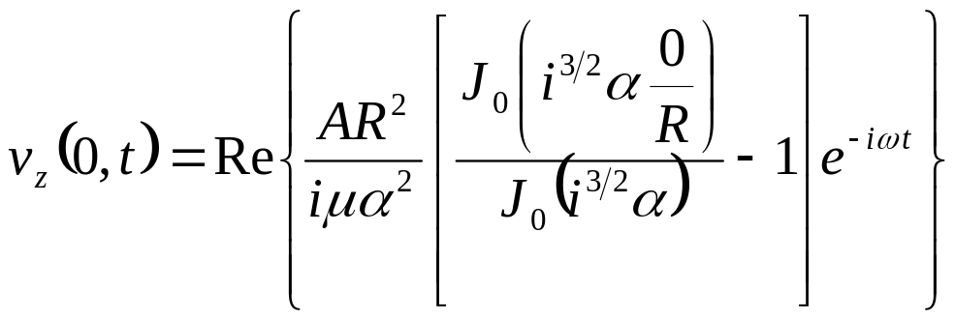
Centerline Velocity
From the solution for velocity as a function of r and t:
We would like to determine the velocity profile in terms of the centerline velocity, u_{z}(0,t). Evaluate the above at r = 0.

Slide 28
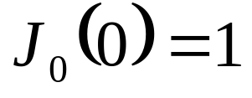




Centerline Velocity
Now note that
, so:
Recall that we can talk about a complex velocity
such that
. Then
.
.

Slide 29






Centerline Velocity
.
We were not given the complex form of
but we were given its magnitude (k) and phase (φ), and we know that for any product of complex numbers AB,
and
Therefore, we can obtain the magnitude and phase of the pressure term A from
as:
,
Since the true pressure gradient is the real part of the complex pressure gradient, we can write:
.

Slide 30


Centerline Velocity
and
,
Since the true pressure gradient is the real part of the complex pressure gradient, we can write:
.

Slide 31

Centerline Velocity
Since the true pressure gradient is the real part of the complex pressure gradient, we can write:
.

Slide 32

The Stress Tensor
For fluids:
The shear stress has 4 non-zero components.

Slide 33


Shear Stress, Bottom Surface
Along the bottom surface, we are concerned only with τ_{xy}.

Slide 34



Wall Shear Stress
Similarly, we could recast the solution in the form of wall shear stress. From this simple geometry, the shear stress reduces to:
To evaluate the derivative, we will need to know the derivatives of the Bessel functions. I.e. we must know that in general:
so that specifically:

Slide 35



Wall Shear Stress
It is left to the student to show that:
and that since:
the flow rate as a function of time is:

Slide 36

Carotid Artery Waveform
A typical example of a carotid artery centerline velocity is shown here. Clearly this waveform is not a pure sine wave. It has a DC component and higher harmonics.
v cm/s
Time (s)

Slide 37

Superposition
If the centerline velocity is periodic. Then it can be represented as a Fourier series:
Because the differential equation is linear, the solution to the above “input” is the same as the sum of solutions to each term. Thus, since we have solved the equation for a single cosine wave, we have solved them for a general case.

